Slide 1
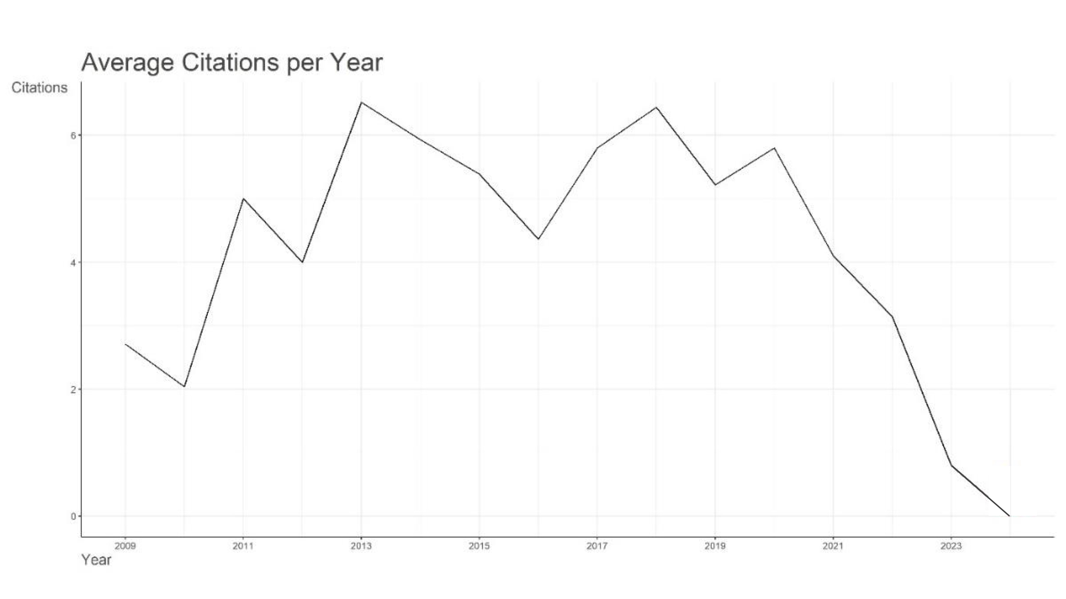

Slide 2
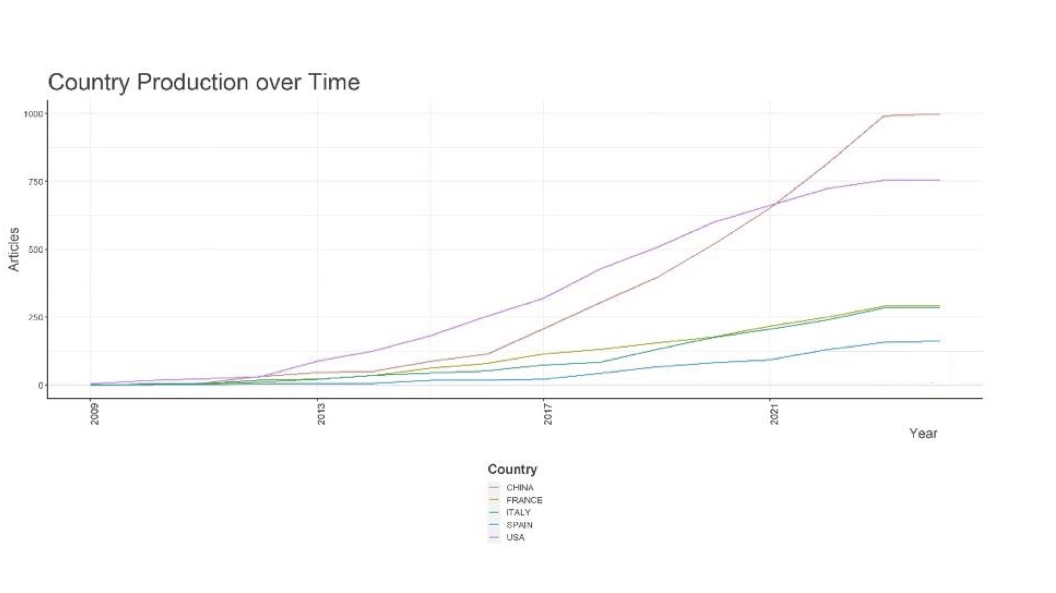

Slide 3
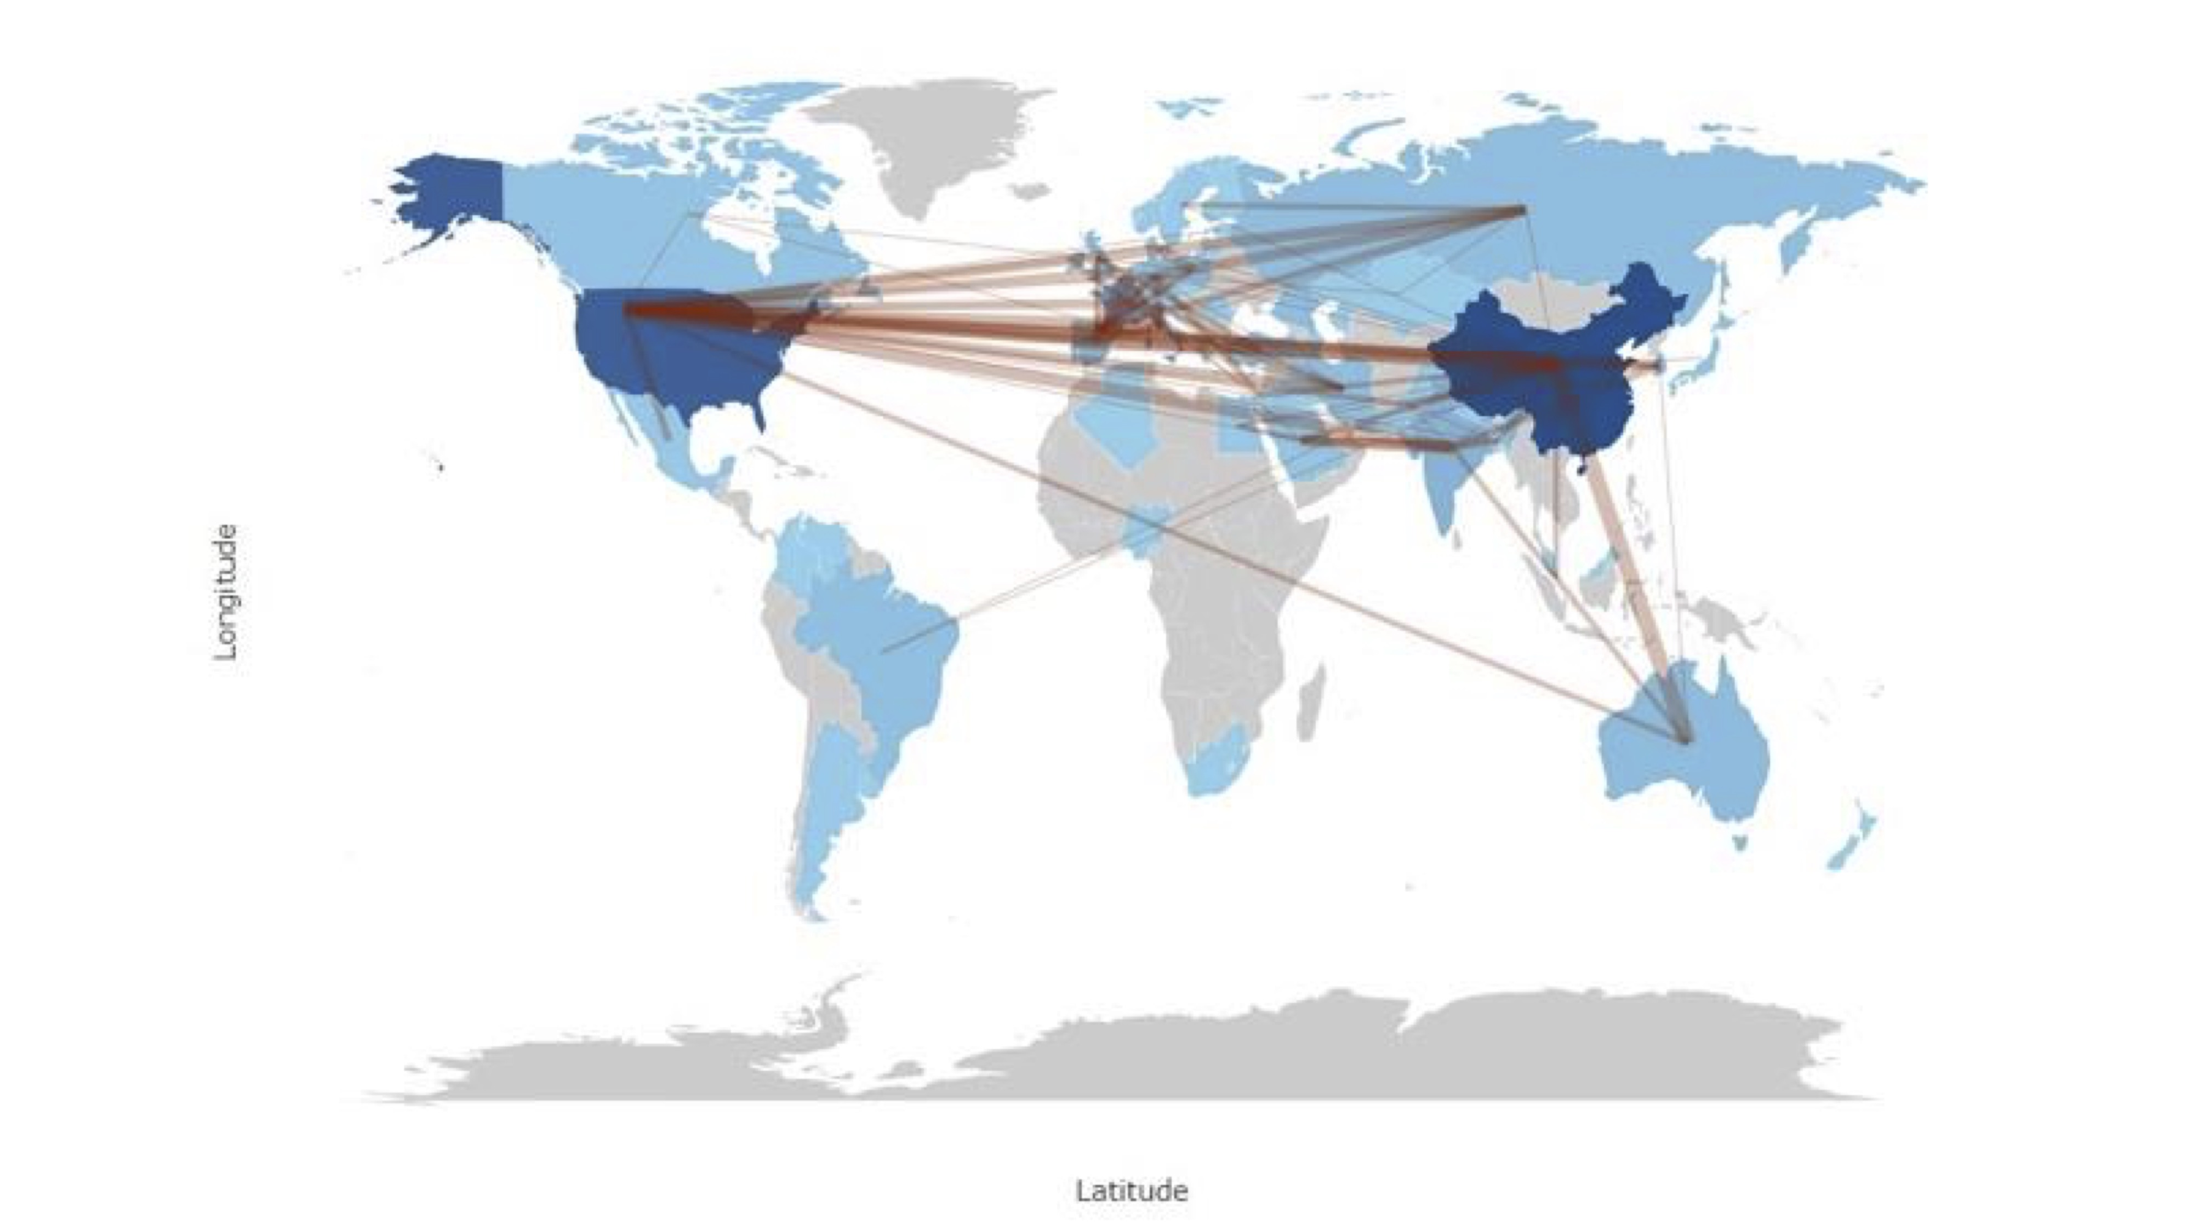

Slide 4
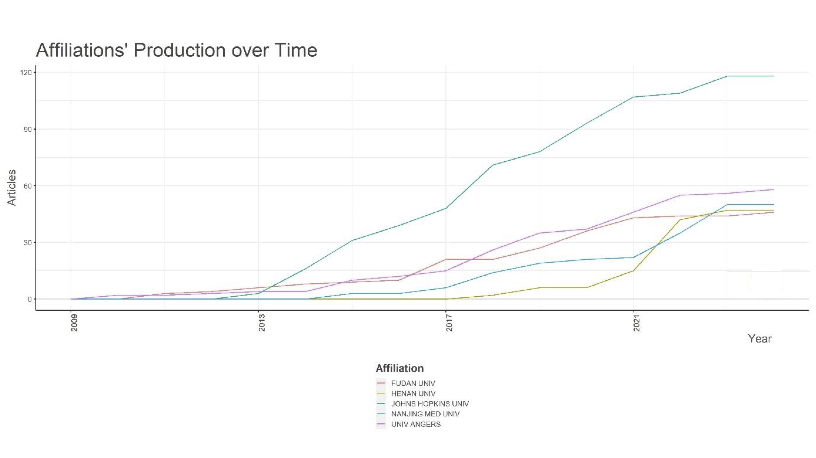

Slide 5
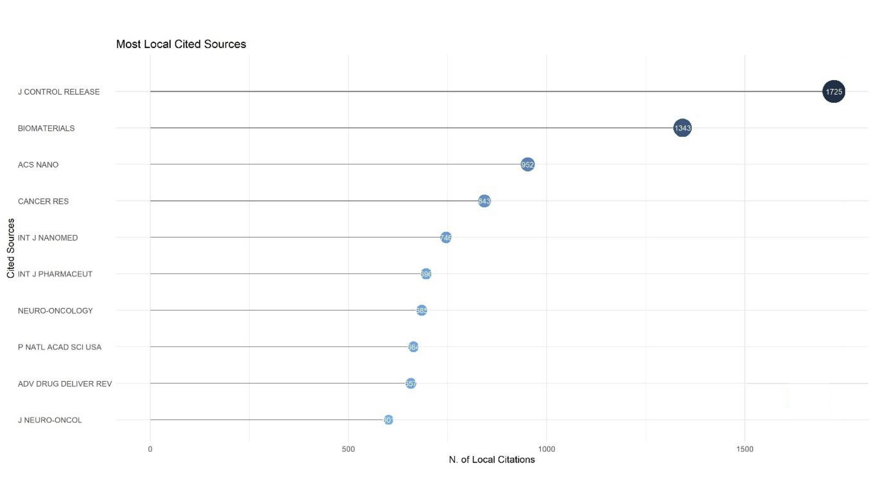

Slide 6
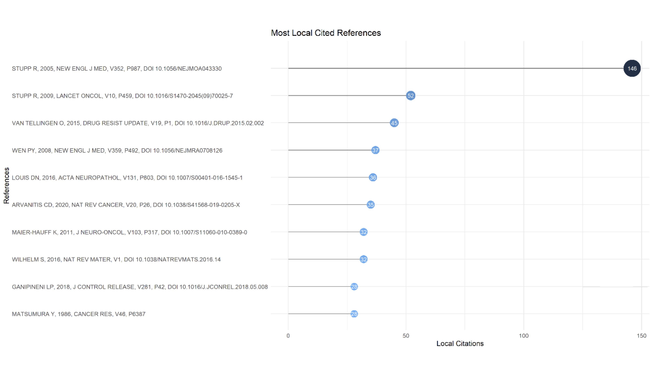

Slide 7
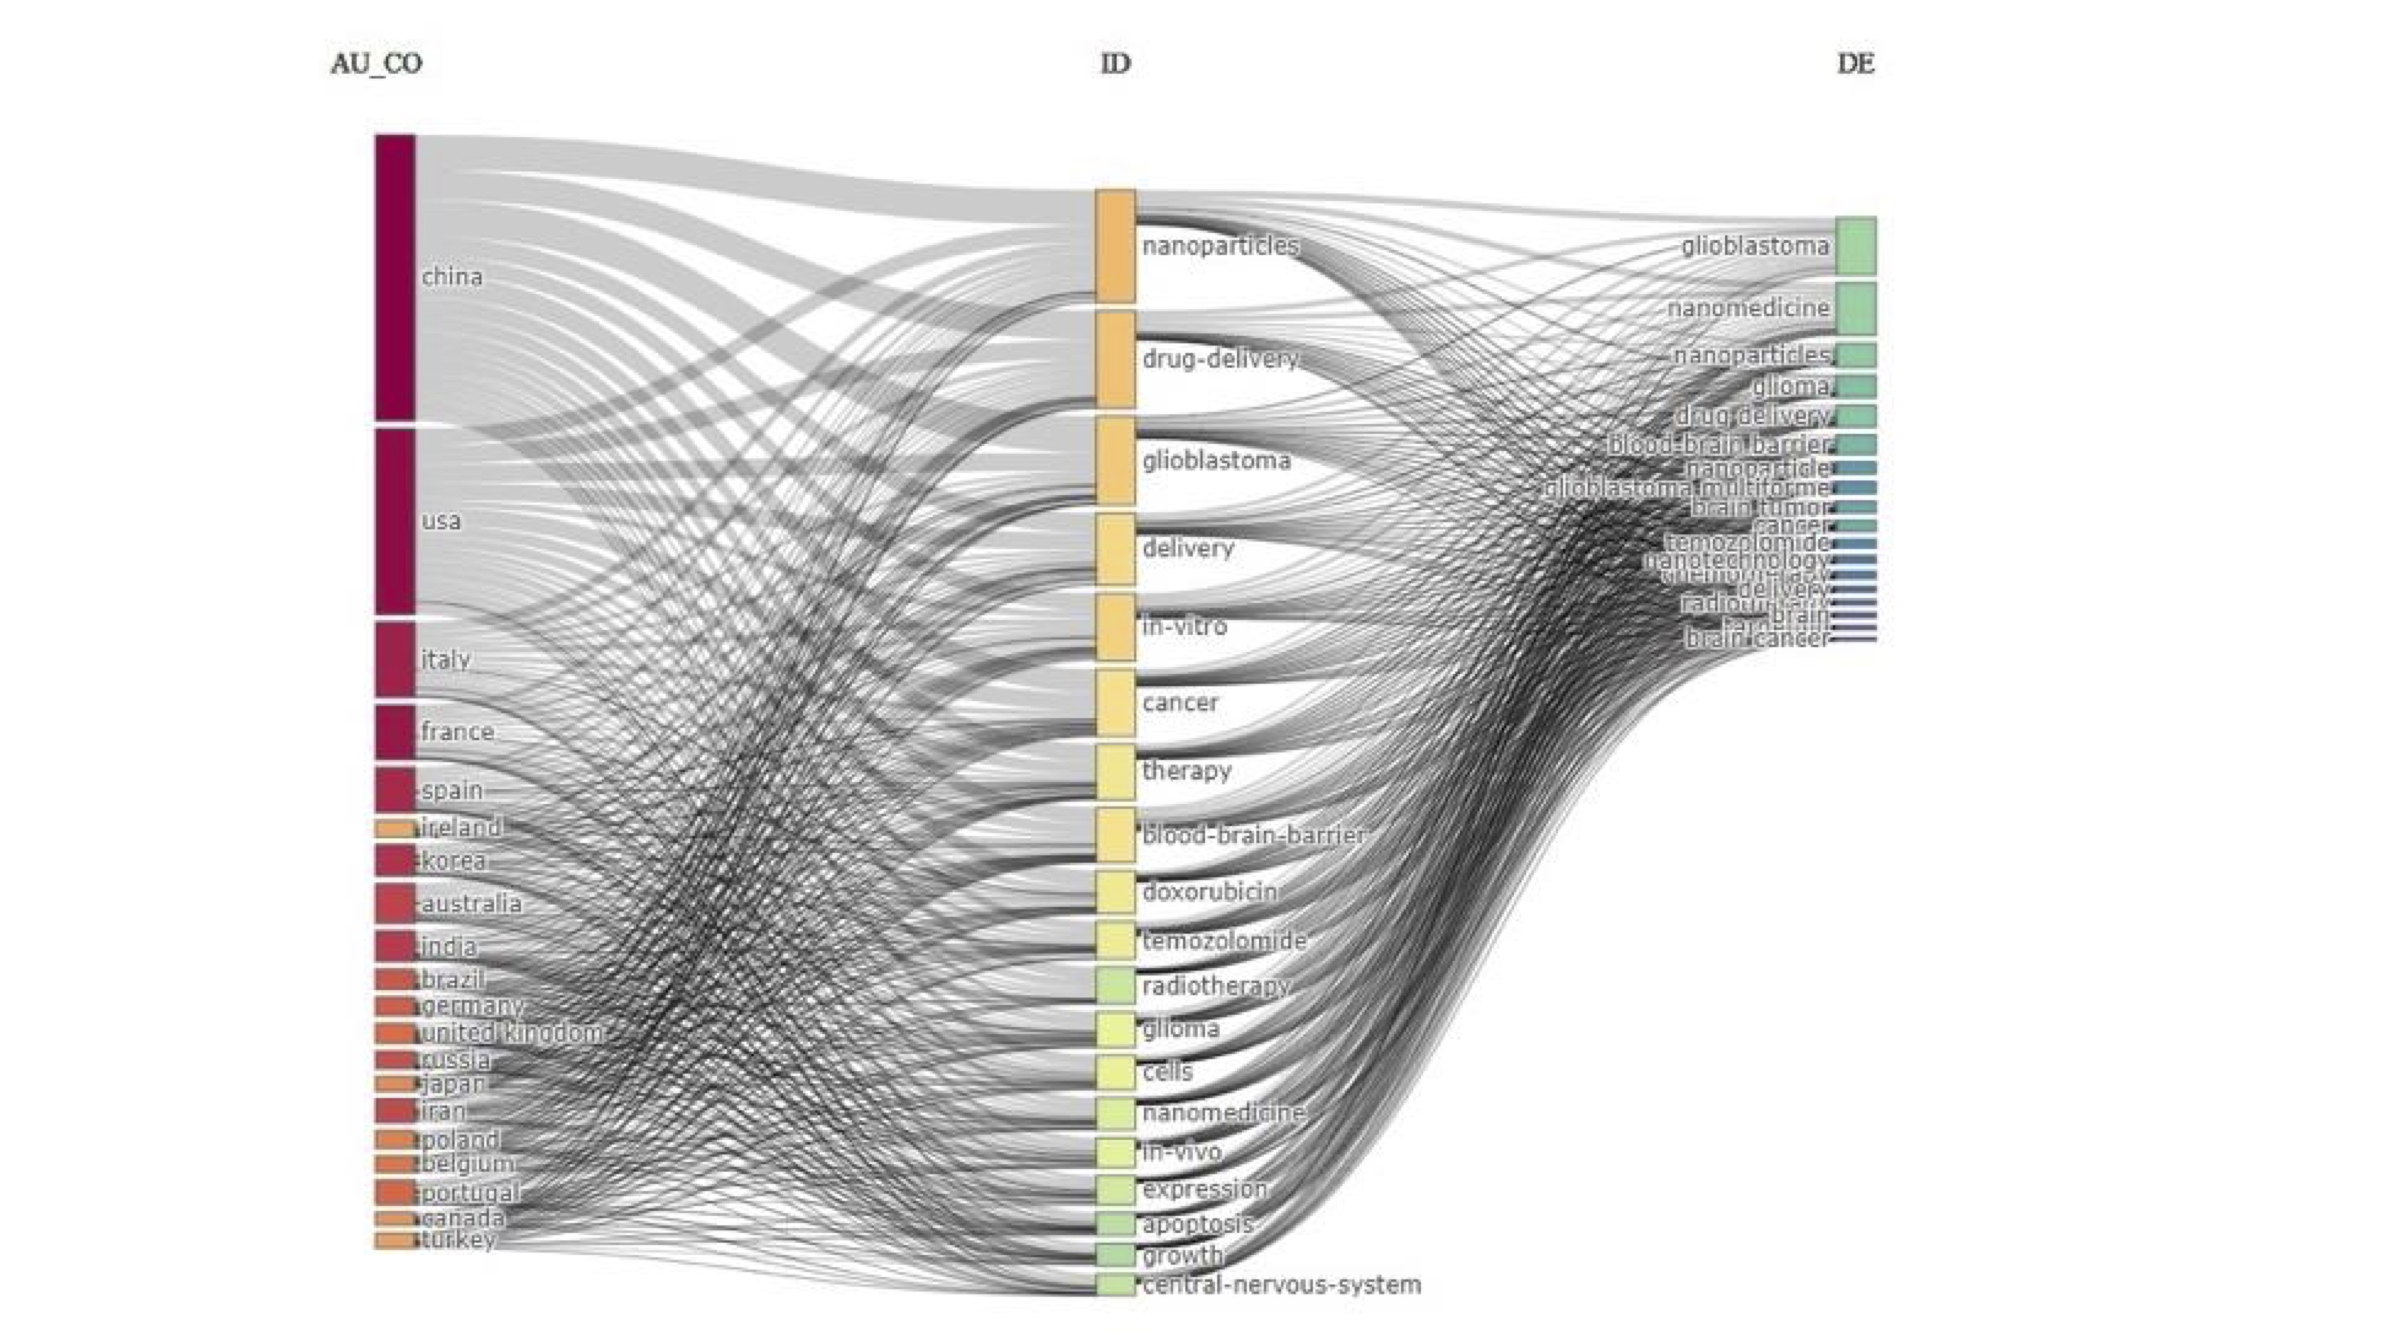

Slide 8
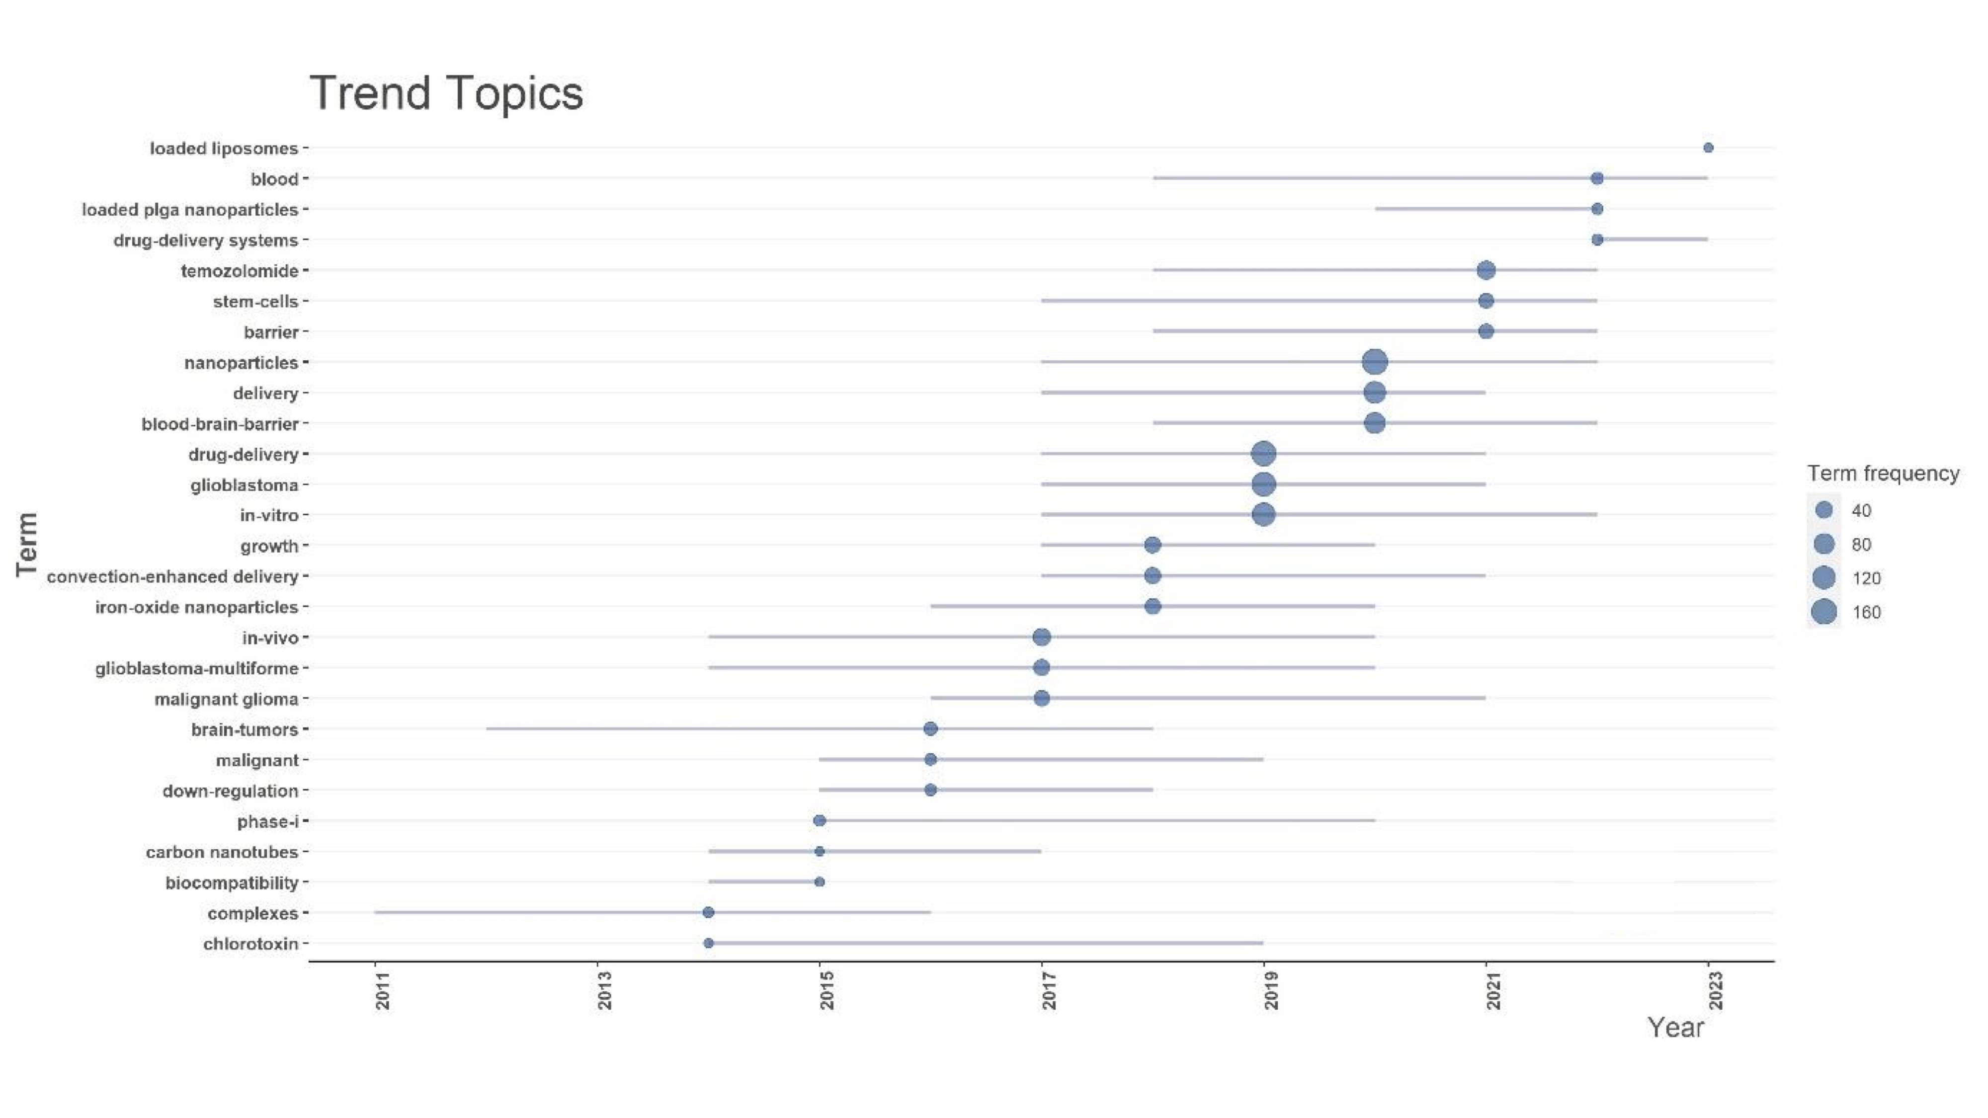

Slide 9
Supplementary 1 (S1). Average citations per year. In 2013, the highest mean of total citations per article (78,51) and per year (6,52) was observed.
Supplementary 2 (S2): Country Production over time. The two main Countries that contributed to production are China and the USA, with 999 and 755 articles, respectively.
Supplementary 3 (S3). Relationship network among countries. China has a strong connection with the USA and Australia, and there is a clear tendency for European countries (blue) to collaborate.
Supplementary 4 (S4). Affiliation’s Production over time. The principal institutions in terms of production were Johns Hopkins University, with 118 articles, followed by the University of Anger, with 58 articles.
Supplementary 5. (S5). Most local cited sources. The most Locally cited sources are J Control Release and Biomaterial, with 1725 and 1343 articles, respectively.
Supplementary 6 (S6). The most local Global cited reference was Stupp R. N Engl J Med. 2005 (146 citations), Stupp R. Lancet Oncol. 2009 May (52 citations).
Supplementary 7 (S7). The main keyword’s authors (right side) resulted in glioblastoma, nanomedicine, nanoparticles, glioma, drug delivery, blood-brain barrier, nanoparticles, glioblastoma multiforme, brain tumors, cancer, temozolomide, nanotechnology, chemotherapy, delivery, radiotherapy, brain, targeted, brain cancer.
Supplementary 8. (S8). Trend topics.

