Slide 1
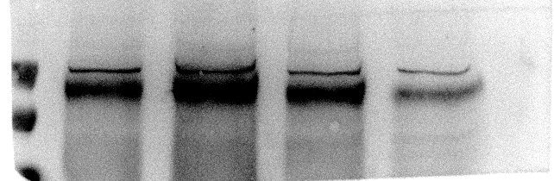
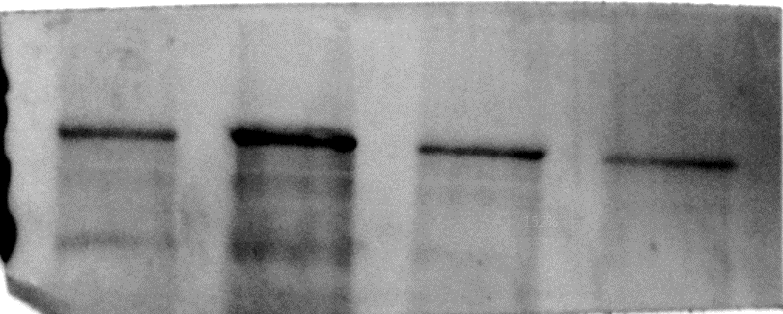
Original Image for checking
Fig.1F
Fig.2B
Fig.2G
miR-365 mimic
miR-365 antisense
SCI-0 d
SCI-1 d
SCI-3 d
SCI-14 d
SCI-14 d
SCI-7 d
SCI-0 d
SCI-1 d
SCI-3 d
NC mimic
NC antisense
Sham
Sham
SCI-7 d
type2 collagen
43kD-
180kD-
95kD-
33kD-
HOXA9
130kD-
Aggrecan
180kD-
Aggrecan
130kD-
130kD-
95kD-
HIF-1α
95kD-
type2 collagen
70kD-
43kD-
Actin
43kD-
Actin
43kD-
Actin

Slide 2
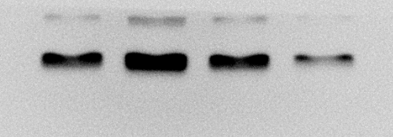
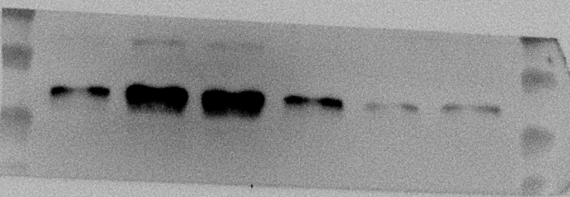
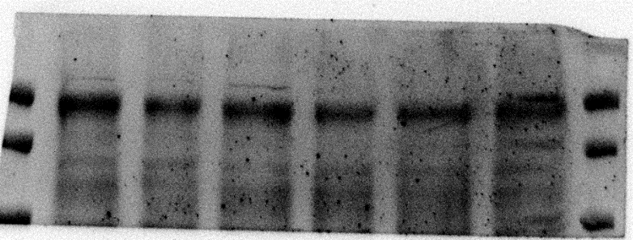
Original Image for checking
Fig.3D
Fig.3G
Fig.4G
HOXA9 OE
HOXA9 siRNA
miR-365 antisense+HOXA9 OE
OE-NC
NC siRNA
miR-365 antisense+OE NC
miR-365 mimic+HOXA9 siRNA
miR-365 mimic
miR-365 antisense
NC antisense+OE NC
miR-365 mimic+NC siRNA
NC mimic
NC antisense
NC mimic+NC siRNA
43kD-
HOXA9
33kD-
43kD-
43kD-
33kD-
HOXA9
33kD-
HOXA9
130kD-
HIF-1α
95kD-
130kD-
HIF-1α
type2 collagen
95kD-
95kD-
43kD-
Actin
180kD-
Aggrecan
Actin
130kD-
43kD-
130kD-
HIF-1α
95kD-
43kD-
Actin

